Slide 1
Monetary Policy Report
January 2020
    The economic outlook

Slide 2
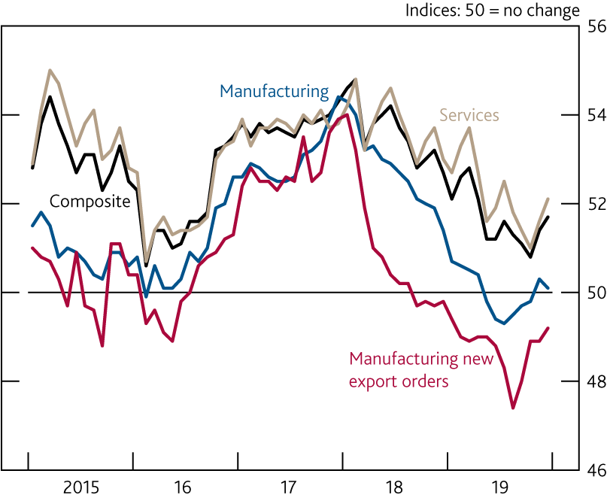
  Chart 1.1 Global PMIs suggest growth is stabilising
    Global purchasing managers’ indices^{(a)}
Sources: Eikon from Refinitiv, IHS Markit and JPMorgan.
Measures of current monthly composite (services and manufacturing) output, manufacturing, services business activity and manufacturing new export orders growth based on the results of surveys in 44 countries. Together these countries account for an estimated 89% of global GDP. Latest data are for December 2019.

Slide 3
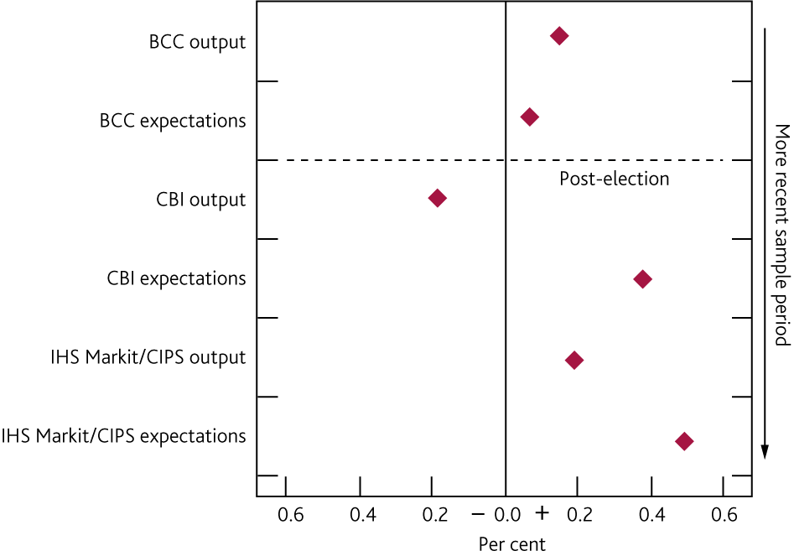
  Chart 1.2 Most recent surveys of output and expectations point to a pickup in GDP growth in 2020 Q1
    Model-based forecasts for quarterly GDP growth in 2020 Q1, based on the latest survey data^{(a)}
Sources: BCC, CBI, IHS Markit/CIPS, ONS and Bank calculations.
Forecasts for GDP growth based on survey indicators of output and expectations. Forecasts use latest values for each survey, assuming those values persist. Q4 surveys for BCC. January surveys for IHS Markit/CIPS. January surveys for CBI used with the prior consent of the CBI.

Slide 4
  Table 1.A Forecast summary^{(a)(b)}
Modal projections for GDP, CPI inflation, LFS unemployment and excess supply/excess demand. Figures in parentheses show the corresponding projections in the November 2019 Monetary Policy Report. Projections were only available to 2022 Q4 in November.
Unless otherwise stated, the projections shown in this section are conditioned on: Bank Rate following a path implied by market yields; the Term Funding Scheme; the Recommendations of the Financial Policy Committee and the current regulatory plans of the Prudential Regulation Authority; the Government’s tax and spending plans as set out in the Spring Statement 2019, updated for the announcements made in Spending Round 2019; commodity prices following market paths for two quarters, then held flat; the sterling exchange rate remaining broadly flat; and the prevailing prices of a broad range of assets, which embody market expectations of the future stocks of purchased gilts and corporate bonds. The main assumptions are set out in the ‘Download the chart slides and data’ link at www.bankofengland.co.uk/monetary-policy-report/2020/january-2020.
Four-quarter growth in real GDP. The growth rates reported in the table exclude the backcast for GDP. Including the backcast 2020 Q1 growth is 0.4%, 2021 Q1 growth is 1.4%,
2022 Q1 growth is 1.6% and 2023 Q1 growth is 2.0%. This compares to 0.7% in 2020 Q1, 1.7% in 2021 Q1 and 1.9% in 2022 Q1 in the November 2019 Monetary Policy Report.
Four-quarter inflation rate.
Per cent of potential GDP. A negative figure implies output is below potential and a positive figure that it is above.
Per cent. The path for Bank Rate implied by forward market interest rates. The curves are based on overnight index swap rates.

Slide 5
  Table 1.B Potential supply growth has slowed and is expected to remain subdued
    Decomposition of estimated potential supply growth^{(a)}
Sources: ONS and Bank calculations.
Average percentage point contributions to annual growth unless otherwise specified. Contributions may not sum to the total due to rounding.
Positive numbers indicate that a fall in the equilibrium unemployment rate has increased potential labour supply.
Based on a growth-accounting framework using a constant returns to scale Cobb-Douglas production function, with total output to capital elasticity of ⅓.
Capital deepening refers to growth in capital services per person-hour.
Total factor productivity growth refers to improvements in the efficiency with which both capital and labour are used to produce output. Calculated as a residual.

Slide 6
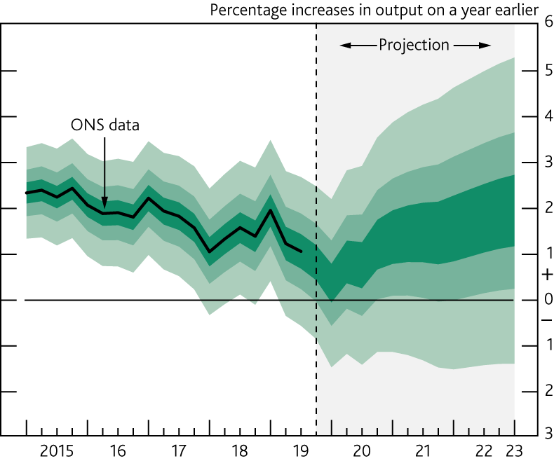
  Chart 1.3 GDP projection based on market interest rate expectations, other policy measures as announced
The fan chart depicts the probability of various outcomes for GDP growth. It has been conditioned on the assumptions in Table 1.A footnote (b). To the left of the vertical dashed line, the distribution reflects uncertainty around revisions to the data over the past. To aid comparability with the official data, it does not include the backcast for expected revisions, which is available from the ‘Download the chart slides and data’ link at www.bankofengland.co.uk/monetary-policy-report/2020/january-2020. To the right of the vertical line, the distribution reflects uncertainty over the evolution of GDP growth in the future. If economic circumstances identical to today’s were to prevail on 100 occasions, the MPC’s best collective judgement is that the mature estimate of GDP growth would lie within the darkest central band on only 30 of those occasions. The fan chart is constructed so that outturns are also expected to lie within each pair of the lighter green areas on 30 occasions. In any particular quarter of the forecast period, GDP growth is therefore expected to lie somewhere within the fan on 90 out of 100 occasions. And on the remaining 10 out of 100 occasions GDP growth can fall anywhere outside the green area of the fan chart. Over the forecast period, this has been depicted by the light grey background. See the box on page 39 of the November 2007 Inflation Report for a fuller description of the fan chart and what it represents.

Slide 7
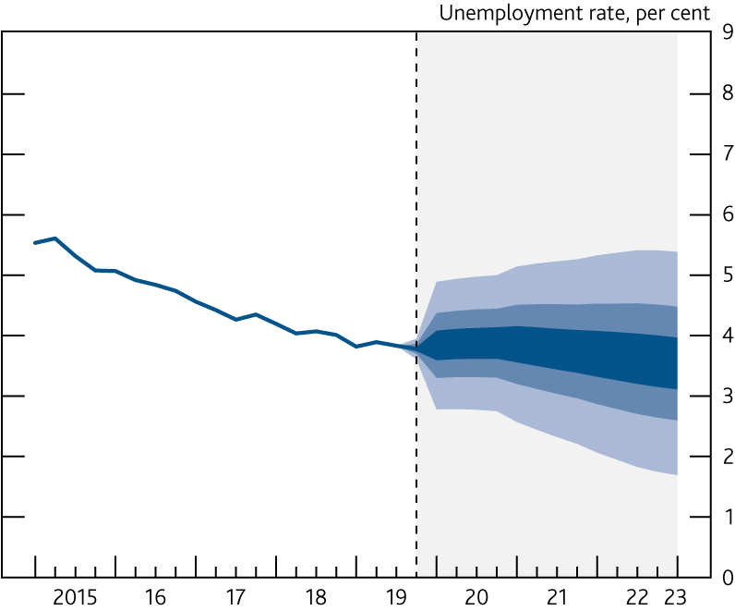
  Chart 1.4 Unemployment projection based on market interest rate expectations, other policy measures as announced
The fan chart depicts the probability of various outcomes for LFS unemployment. It has been conditioned on the assumptions in Table 1.A footnote (b). The coloured bands have the same interpretation as in Chart 1.3, and portray 90% of the probability distribution. The calibration of this fan chart takes account of the likely path dependency of the economy, where, for example, it is judged that shocks to unemployment in one quarter will continue to have some effect on unemployment in successive quarters. The fan begins in 2019 Q4, a quarter earlier than the fan for CPI inflation. That is because Q4 is a staff projection for the unemployment rate, based in part on data for October and November. The unemployment rate was 3.8% in the three months to November, and is projected to be 3.8% in Q4 as a whole. A significant proportion of this distribution lies below Bank staff’s current estimate of the long-term equilibrium unemployment rate. There is therefore uncertainty about the precise calibration of this fan chart.

Slide 8
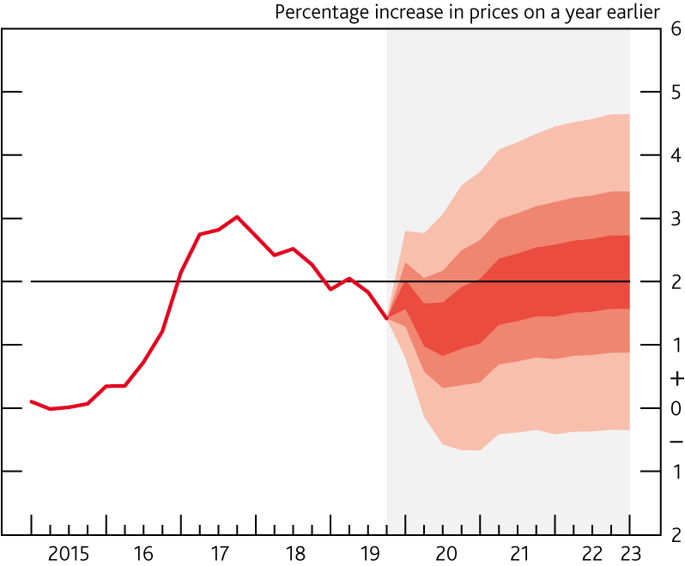
  Chart 1.5 CPI inflation projection based on market interest rate expectations, other policy measures as announced
Chart 1.5 depicts the probability of various outcomes for CPI inflation in the future. It has been conditioned on the assumptions in Table 1.A footnote (b). If economic circumstances identical to today’s were to prevail on 100 occasions, the MPC’s best collective judgement is that inflation in any particular quarter would lie within the darkest central band on only 30 of those occasions. The fan chart is constructed so that outturns of inflation are also expected to lie within each pair of the lighter red areas on 30 occasions. In any particular quarter of the forecast period, inflation is therefore expected to lie somewhere within the fans on 90 out of 100 occasions. And on the remaining 10 out of 100 occasions inflation can fall anywhere outside the red area of the fan chart. Over the forecast period, this has been depicted by the light grey background. See the box on pages 48–49 of the May 2002 Inflation Report for a fuller description of the fan chart and what it represents.

Slide 9
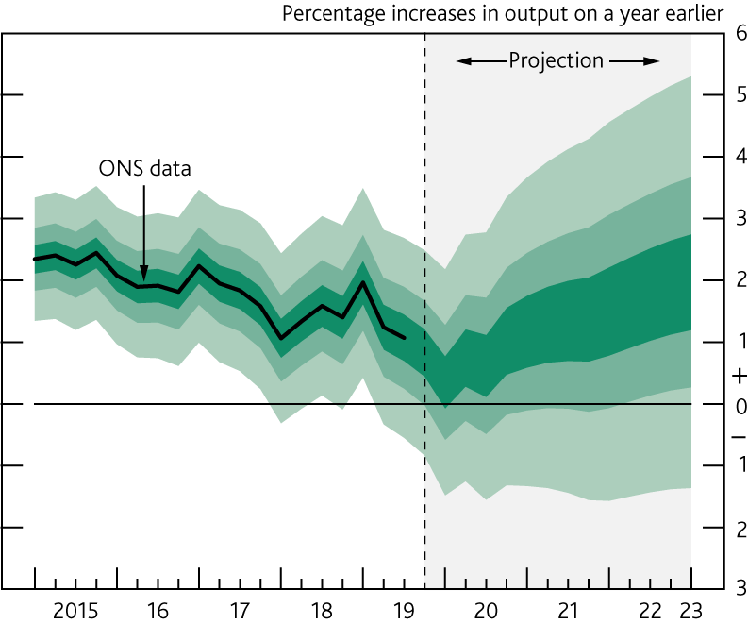
  Chart 1.6 GDP projection based on constant nominal interest rates at 0.75%, other policy measures as announced
See footnote to Chart 1.3.

Slide 10
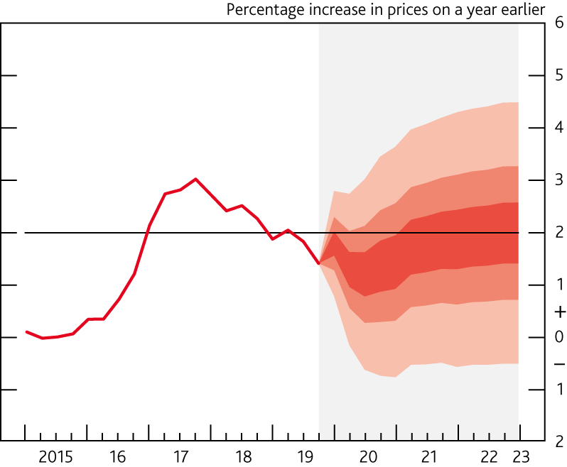
  Chart 1.7 CPI inflation projection based on constant nominal interest rates at 0.75%, other policy measures as announced
See footnote to Chart 1.5.

Slide 11
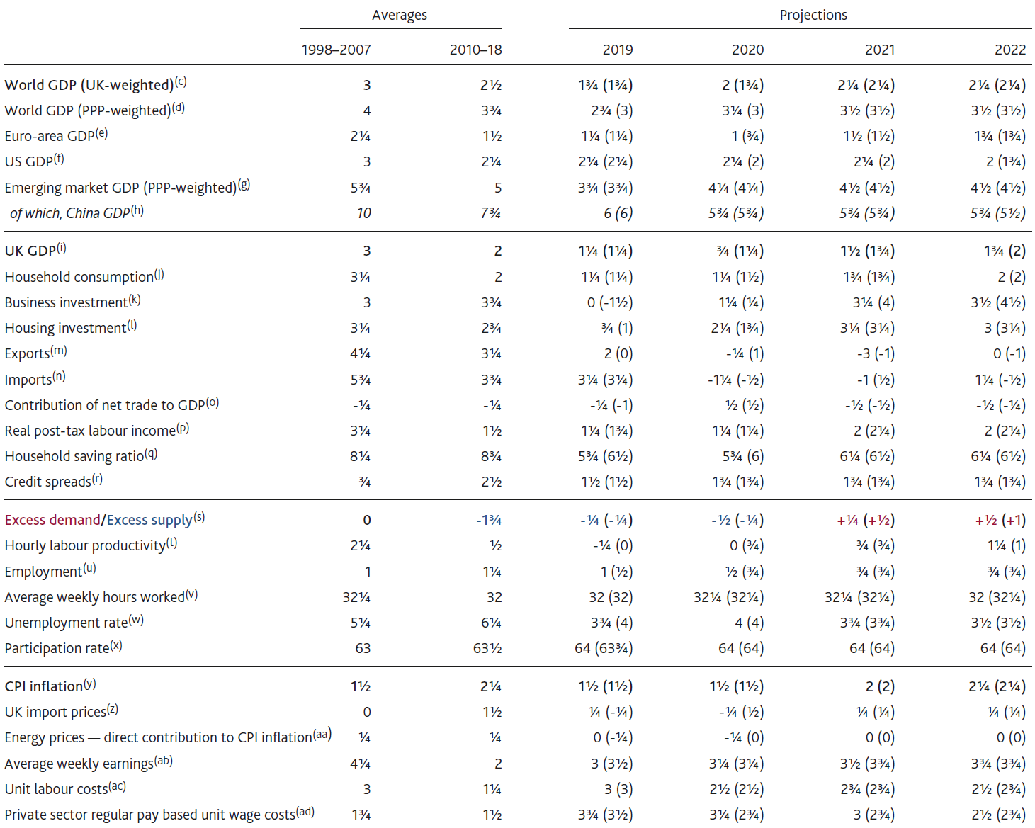
  Table 1.C Indicative projections consistent with the MPC’s forecast^{(a)(b)}

Slide 12
  Table 1.C Indicative projections consistent with the MPC’s forecast^{(a)(b)}
Sources: Bank of England, Bloomberg Finance L.P., Department for Business, Energy and Industrial Strategy, Eurostat, IMF World Economic Outlook (WEO), National Bureau of Statistics of China, ONS, US Bureau of Economic Analysis and Bank calculations.
(a) The profiles in this table should be viewed as broadly consistent with the MPC’s projections for GDP growth, CPI inflation and unemployment (as presented in the fan charts).
(b) Figures show annual average growth rates unless otherwise stated. Figures in parentheses show the corresponding projection in the November 2019 Monetary Policy Report. Calculations for back data based on ONS data are shown using ONS series identifiers.
(c) Chained-volume measure. Constructed using real GDP growth rates of 188 countries weighted according to their shares in UK exports.
(d) Chained-volume measure. Constructed using real GDP growth rates of 189 countries weighted according to their shares in world GDP using the IMF’s purchasing power parity (PPP) weights.
(e) Chained-volume measure.
(f) Chained-volume measure.
(g) Chained-volume measure. Constructed using real GDP growth rates of 155 EME countries, as defined by the IMF WEO, weighted according to their relative shares in world GDP using the IMF’s PPP weights.
(h) Chained-volume measure.
(i) Excludes the backcast for GDP.
(j) Chained-volume measure. Includes non-profit institutions serving households. Based on ABJR+HAYO.
(k) Chained-volume measure. Based on GAN8.
(l) Chained-volume measure. Whole-economy measure. Includes new dwellings, improvements and spending on services associated with the sale and purchase of property. Based on DFEG+L635+L637.
(m) Chained-volume measure. The historical data exclude the impact of missing trader intra‑community (MTIC) fraud. Since 1998 based on IKBK-OFNN/(BOKH/BQKO). Prior to 1998 based on IKBK.
(n) Chained-volume measure. The historical data exclude the impact of MTIC fraud. Since 1998 based on IKBL-OFNN/(BOKH/BQKO). Prior to 1998 based on IKBL.
(o) Chained-volume measure. Exports less imports. GDP data based on the mode of the MPC’s GDP backcast.
(p) Wages and salaries plus mixed income and general government benefits less income taxes and employees’ National Insurance contributions, deflated by the consumer expenditure deflator. Based on [ROYJ+ROYH-(RPHS+AIIV-CUCT)+GZVX]/[(ABJQ+HAYE)/(ABJR+HAYO)].
(q) Annual average. Percentage of total available household resources. Based on NRJS.
(r) Level in Q4. Percentage point spread over reference rates. Based on a weighted average of household and corporate loan and deposit spreads over appropriate risk-free rates. Indexed to equal zero in 2007 Q3.
(s) Annual average. Per cent of potential GDP. A negative figure implies output is below potential and a positive figure that it is above.
(t) GDP per hour worked. GDP data based on the mode of the MPC’s GDP backcast. Hours worked based on YBUS.
(u) Four-quarter growth in LFS employment in Q4. Based on MGRZ.
(v) Level in Q4. Average weekly hours worked, in main job and second job. Based on YBUS/MGRZ.
(w) LFS unemployment rate in Q4. Based on MGSX.
(x) Level in Q4. Percentage of the 16+ population. Based on MGWG.
(y) Four-quarter inflation rate in Q4.
(z) Four-quarter inflation rate in Q4 excluding fuel and the impact of MTIC fraud.
(aa) Contribution of fuels and lubricants and gas and electricity prices to four-quarter CPI inflation in Q4.
(ab) Four-quarter growth in whole-economy total pay in Q4. Growth rate since 2001 based on KAB9. Prior to 2001, growth rates are based on historical estimates of AWE, with ONS series identifier M09M.
(ac) Four-quarter growth in unit labour costs in Q4. Whole‑economy total labour costs divided by GDP at constant prices, based on the mode of the MPC’s GDP backcast. Total labour costs comprise compensation of employees and the labour share multiplied by mixed income.
(ad) Four-quarter growth in private sector regular pay based unit wage costs in Q4. Private sector wage costs divided by private sector output at constant prices, based on the mode of the MPC’s GDP backcast. Private sector wage costs are average weekly earnings (excluding bonuses) multiplied by private sector employment.

